Slide 1
PROJECT TITLE Calcium imaging analysis for detection of neurons in a brain
PIP104 University Project-II
Review-1
Batch Number:
Roll Number | Student Name
20211LCA0002 | Gagan M Shetty
Under the Supervision of,
Dr. Alamelu Mangai J
Dr. Hsien Sung Huang
Professor : Hsien-Sung Huang (黃憲松), Ph.D. Graduate Institute of Brain and Mind Sciences (腦與心智科學研究所) College of Medicine
National Taiwan University
Tel: 886-2-2312-3456 ext. 288876 (O); 288877 (L)
Lab webpage (http://www.huanglab.com.tw/)

Slide 2
PROJECT TITLE Calcium imaging analysis for detection of neurons in a brain
PIP104 University Project-II
Review-2
Batch Number:
Roll Number | Student Name
20211LCA0002 | Gagan M Shetty
Under the Supervision of,
Dr. Alamelu Mangai J
Dr. Hsien Sung Huang
Professor : Hsien-Sung Huang (黃憲松), Ph.D. Graduate Institute of Brain and Mind Sciences (腦與心智科學研究所) College of Medicine
National Taiwan University
Tel: 886-2-2312-3456 ext. 288876 (O); 288877 (L)
Lab webpage (http://www.huanglab.com.tw/)

Slide 3
PROJECT TITLE Calcium imaging analysis for detection of neurons in a brain
PIP104 University Project-II
Review-3
Batch Number:
Roll Number | Student Name
20211LCA0002 | Gagan M Shetty
Under the Supervision of,
Dr. Alamelu Mangai J
Dr. Hsien Sung Huang
Professor : Hsien-Sung Huang (黃憲松), Ph.D. Graduate Institute of Brain and Mind Sciences (腦與心智科學研究所) College of Medicine
National Taiwan University
Tel: 886-2-2312-3456 ext. 288876 (O); 288877 (L)
Lab webpage (http://www.huanglab.com.tw/)

Slide 4
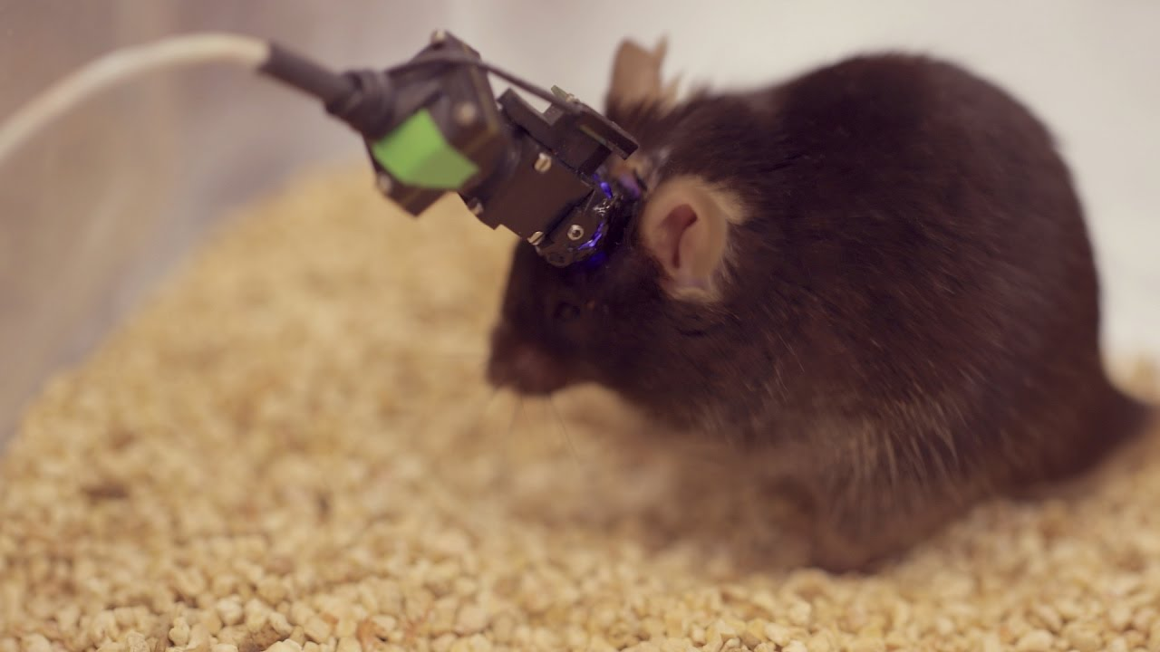
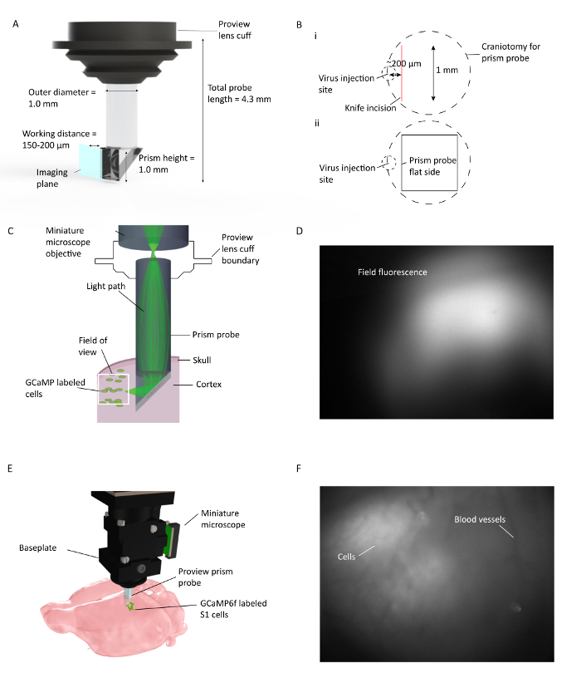
Introduction
Calcium imaging
Inscopix miniscope
The objective of this project is to create a automated software designed for the analysis of calcium imaging. Calcium imaging serves as a technique to identify the neurons, from a data collected through various methods in our lab we employ inscopix miniscope to gather data from the brain of freely moving mice. The collected data undergoes various analyses has inscopix is a device which is connected to mice brain as depicted in figure 1.1 is a device connected to mice brains. However this connections introduces unwanted noise, leading to the generation of spikes in the data.

Slide 5
Difficulties with existing software
Inscopix Preprocessing software
It contains a built in code on PCA Technique and CNMFE, Caiman implementation after applying this methods we get a raw csv data from a video data and we do analysis by various visualization methods and get a accuracy of neuron points Region of interest (ROI).
Neuron identification F1 score/accuracy
Spike identification
Synchronisation index

Slide 6
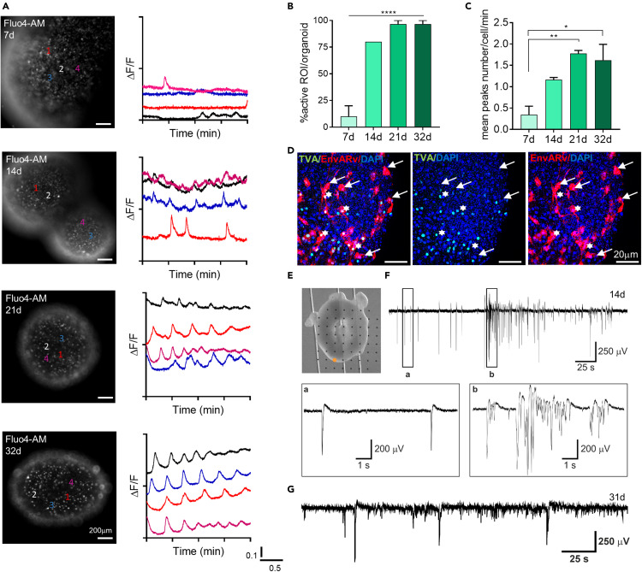
Analysis

Slide 7
Timeline of project
Month 1 : Learning calcium imaging and doing analysis using excel data for heatmap and traces for each neuron.
Month 2: Learning about neurons traces and developing software for existing libraries and codes.
Month 3: Developing software and testing with different data.

Slide 8
Procedure to calcium imaging
Calcium dye
Cal 520
Fluorocense

Slide 9
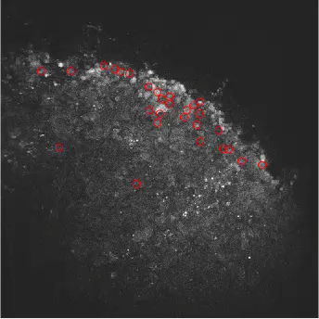
Calcium imaging

Slide 10
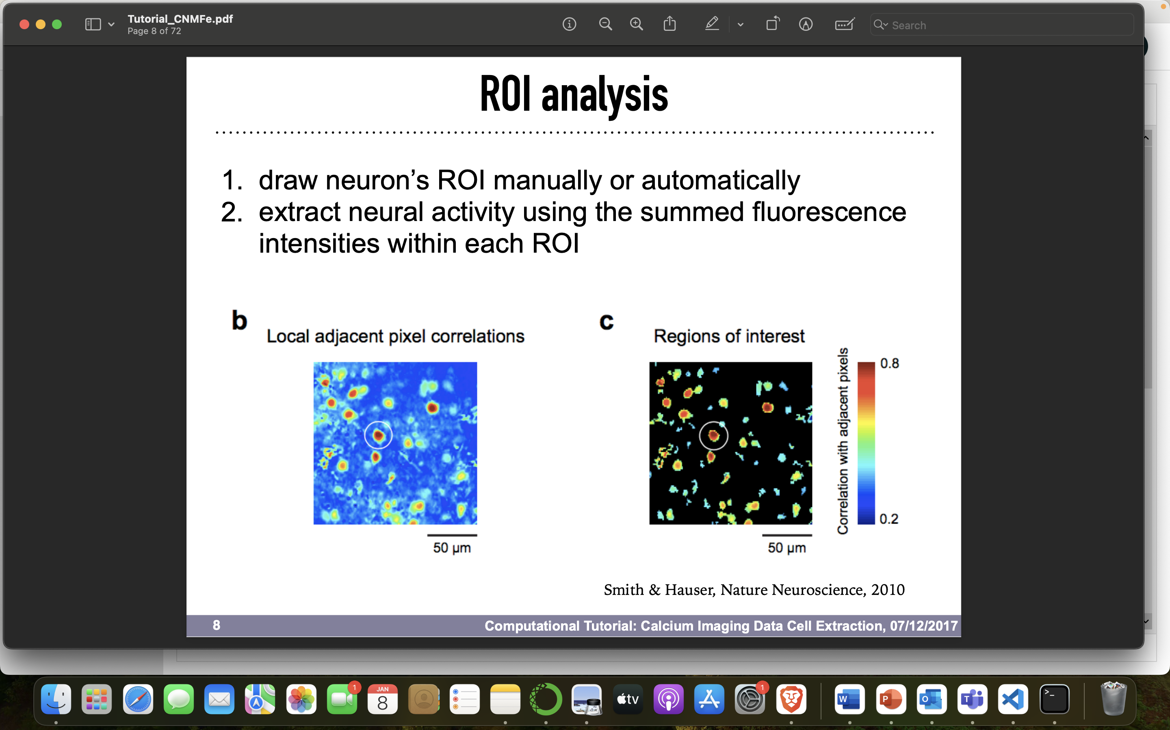

Slide 11
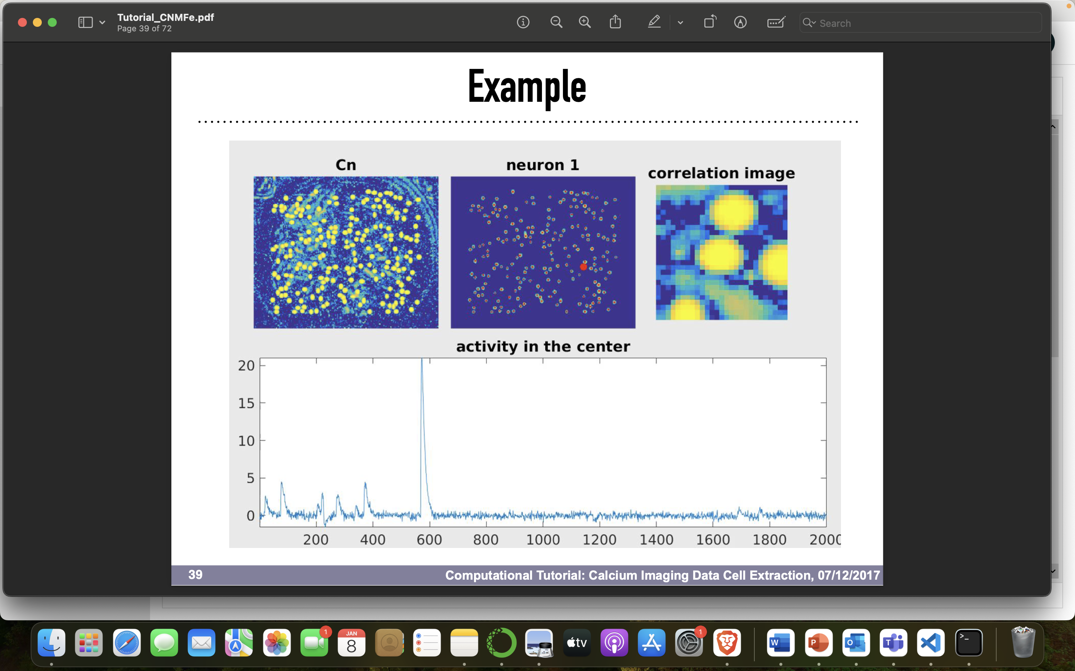

Slide 12
Introduction to libraries for calcium imaging
caiman is a package developed by Giovannucci et al. to analyze brain images on large scale to test the package in a real time Giovannucci et al asked several trained annotators to identify active neurons that were round and donut-shaped in several sets of imaging data from mouse brains each set of data was analyzed by three or more researches then discussed to conclude then they employed using caiman package and later they analyzed it was similar to human identified active neurons in brain image. Has caiman is a open source platform so many laboratories are using it now and it can be customized according to requirements of lab for further usage.
CNMFE is a package also known as constrained non negative matrix factorization this is a combination of auto sklearn to identify the spatial and temporal traces of neurons from a large scale of data but this package is used for micro endoscopic data. (space and Time)
Carignan: this is also a fully automated software tool for analysis of calcium imaging in large scale data analysis but this is a software which is developed by combination of caiman, cnmfe and auto-sklearn used for both 1p and 2p miniscope data but this software implementation is very difficult has auto-sklearn is not supported for both windows and macOS it only works with docker.
Auto-Sklearn: Auto- sklearn is a machine learning tool that is designed to streamline and automate the process of applying machine learning to real world problems. This algorithm will help us to choose best algorithm approach and it also gives all the analysis parameters with accuracy, F1 score etc..

Slide 13
Analysis task
motion correction: addressing any motion artifacts in the data to enhance accuracy.
spike detection: identifying and isolating the spikes within collected data.
memory mapping: organizing and mapping the data in a systematic and efficient manner for analysis.
identifying neurons: clearly distinguishing and labeling neurons within the dataset.
Deconvolving: unraveling the complex signals by separating overlapping or intertwined elements within the data.

Slide 14
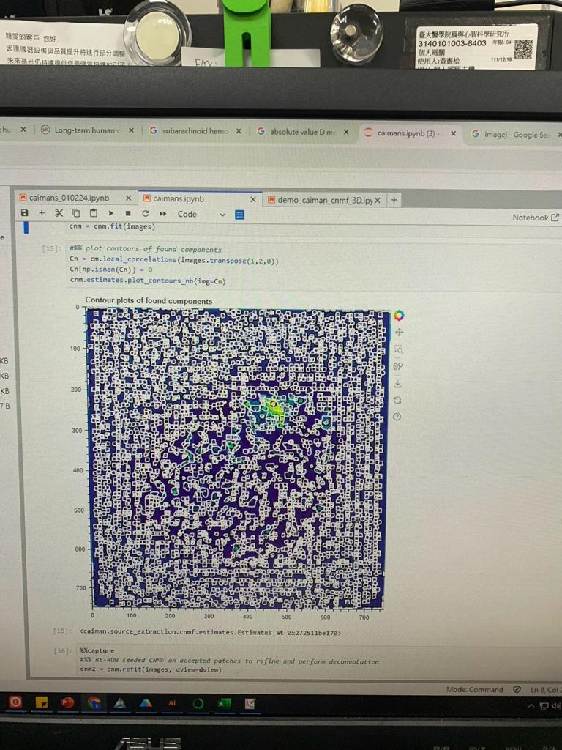
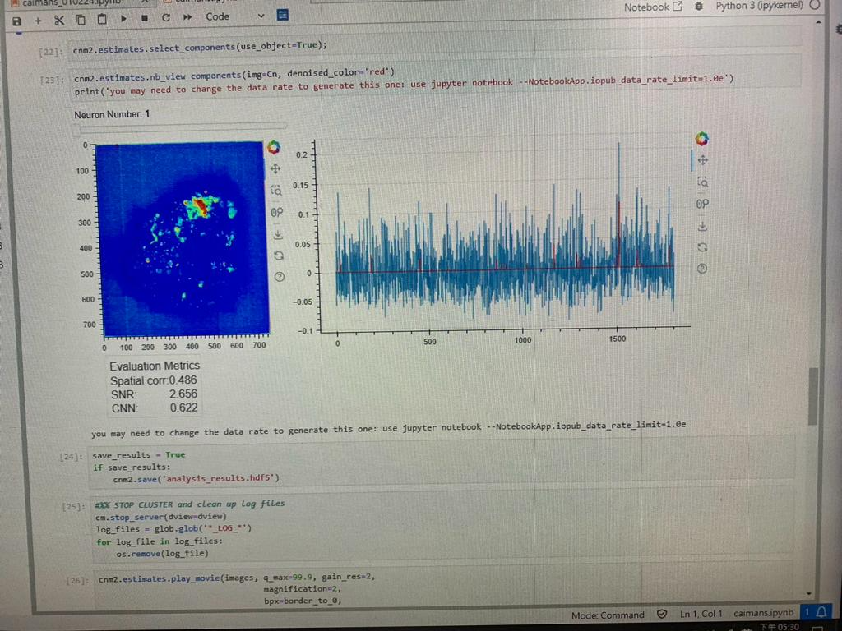

Slide 15
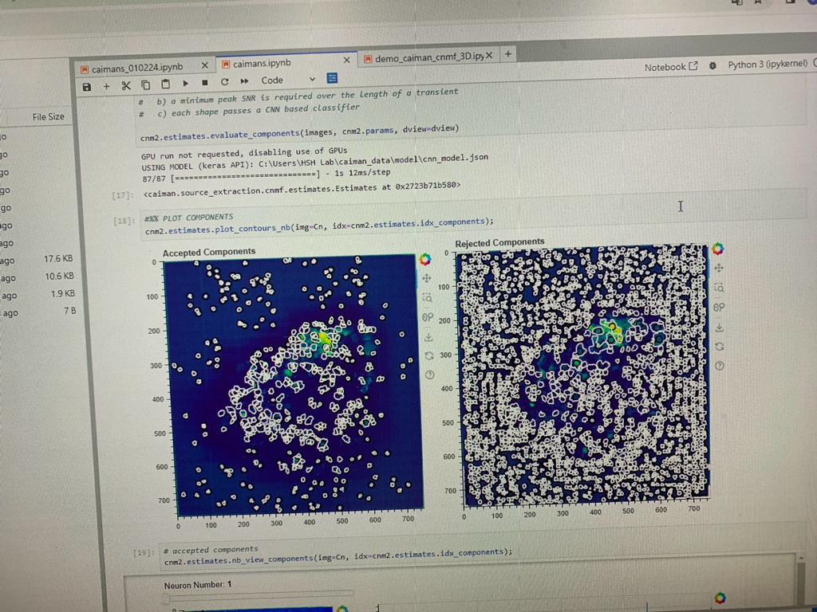
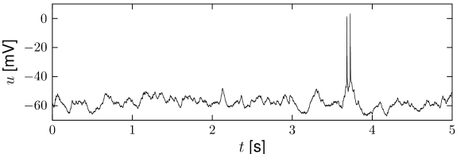
Neuron Detection

Slide 16
Thank You

